Slide 1
Reinforcement Learning
Policy Gradients and Reinforce
Introduction to Deep Learning: Class 7.4

Slide 2
Module outline
Class | Title | Main output
1 | Bandits, MDPs, Returns | agent/environment/reward
2 | Value Functions and Bellman Equations | Learning to solve a reinforcement learning problems by iteratively estimating the value of a state
3 | Monte Carlo, TD, SARSA, Q-Learning | On-policy vs off-policy, sampled experience
4 | Policy Gradients and REINFORCE | log-prob weighted by reward
5 | Actor-Critic and PPO | advantage, critic, clipping
6 | RLHF and GRPO | PPO/GRPO to LLM training

Slide 3
Agenda and references
Agenda:
1. Why value-based methods are not always enough.
2. What a parameterized stochastic policy is.
3. The policy objective J(θ).
4. The log-derivative trick.
5. The REINFORCE gradient estimator.
6. Why policy-gradient methods increase probabilities of rewarding actions.
8. How to implement REINFORCE in PyTorch.
9. How this connects to LLM sequence-level reinforcement learning.

Slide 4
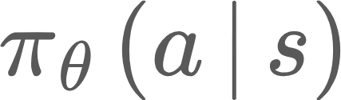
Main idea
So far, we learnt about value functions and action value functions and then we use those functions to choose the optimal action.
But for many modern RL problems, especially neural policies and LLMs, we want to directly optimize a parameterized policy:
to learn how to modify the model’s parameters to make high reward trajectories more likely.
This maps directly to LLMs, because at every decode step, the LLM produces a probability distribution over tokens (actions). That takes us deterministically to the next state, where we run decode again..
Sequence of generated tokens is the trajectory. At the end of the generation (or also in between), we get a reward. Goal is to find the best policy (network parameters) to maximise reward

Slide 5
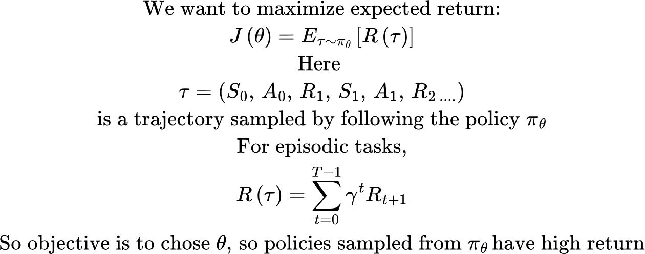
Policy objective

Slide 6
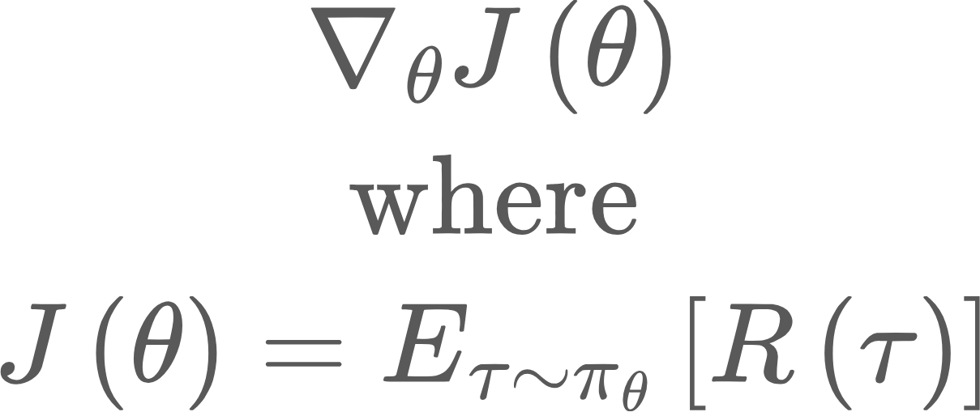
Log derivative trick
We need
The distribution over trajectories depends on the policy pi_theta.
That is, changing the policy changes which trajectories we sample.
So we need a way to differentiate an expectation over samples from the policy.
This is where the log-derivative trick enters.

Slide 7
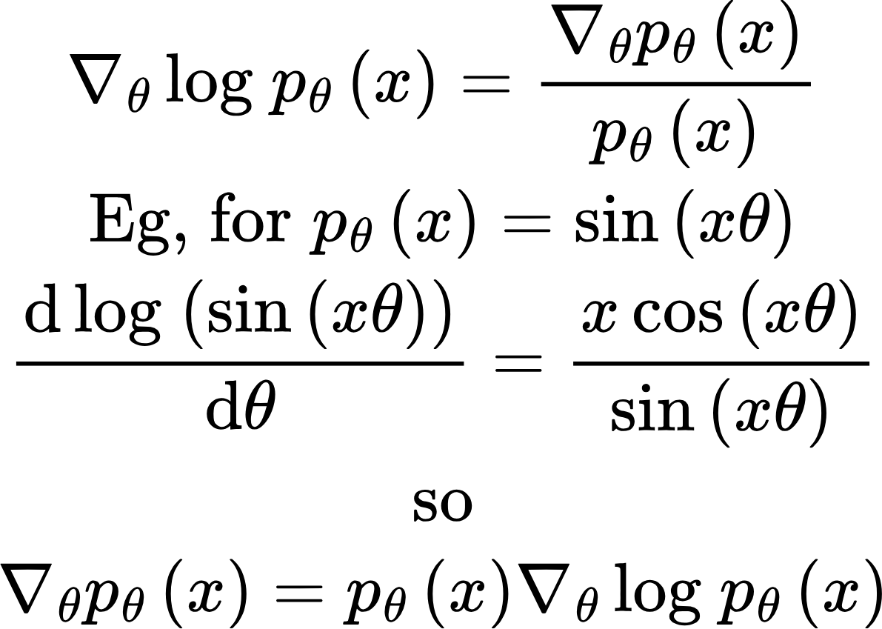
Log derivative trick
This helps us move gradients into log probabilities

Slide 8
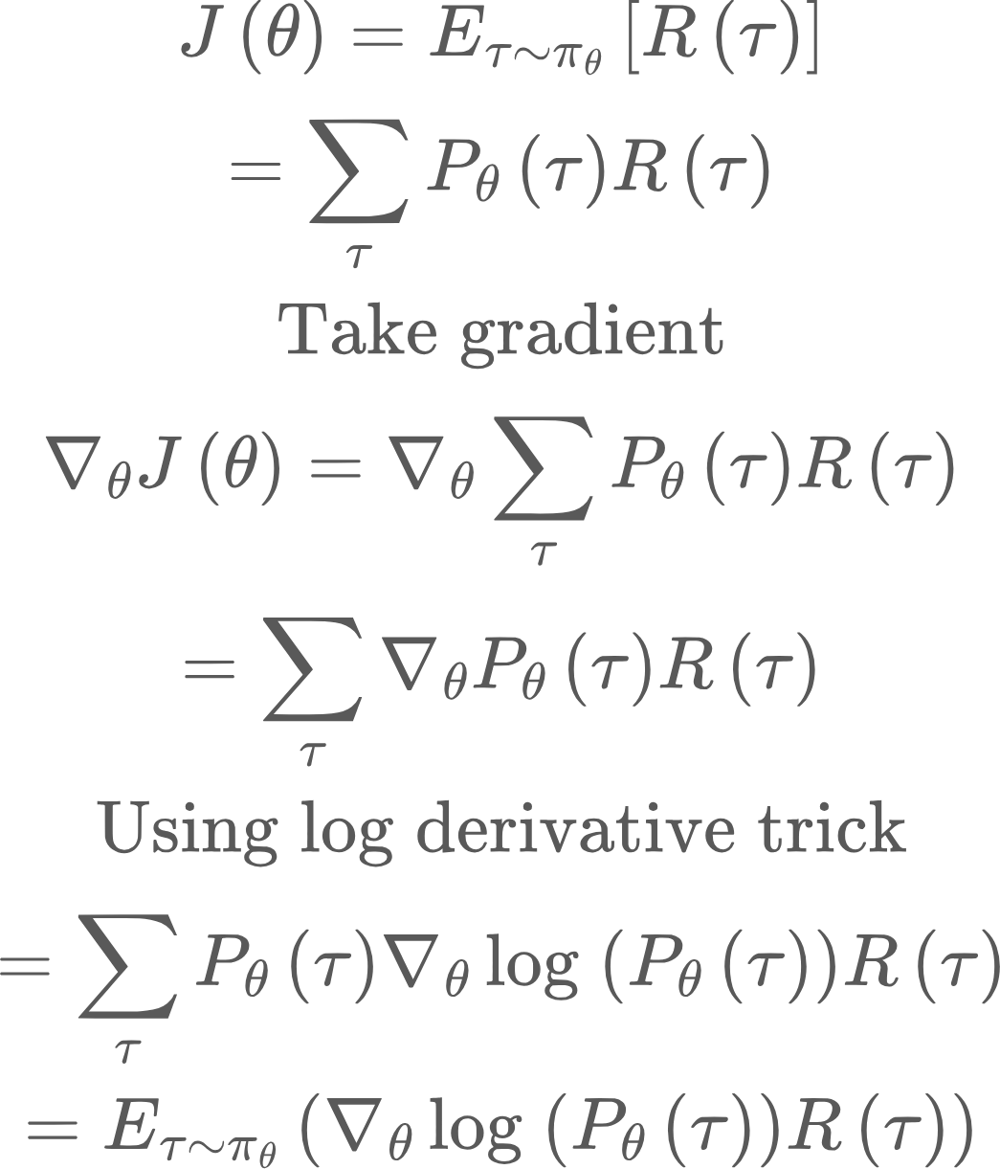
Policy gradient
So now we no longer have the gradient of an expectation, rather expectation of a gradient.. But how do we calculate the probability of a trajectory under a model theta?

Slide 9
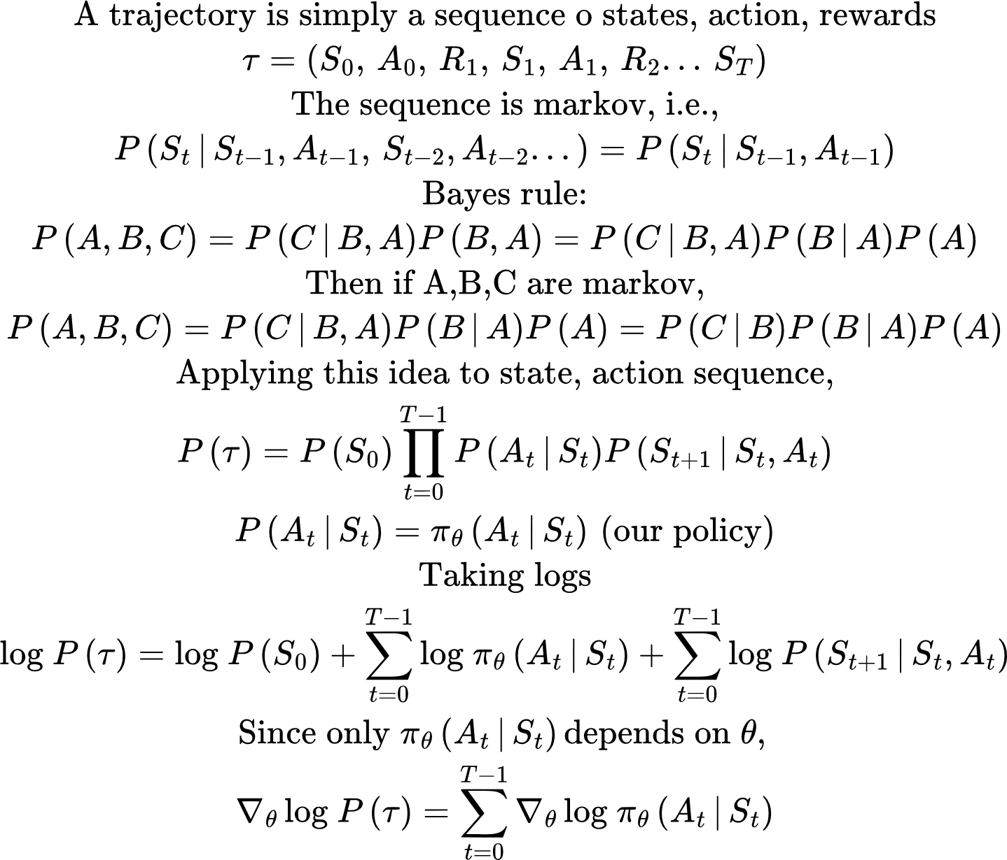
Policy gradient

Slide 10
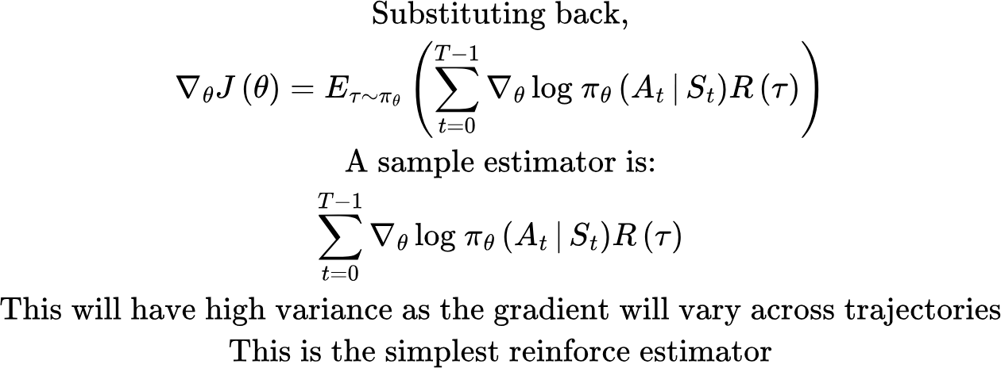
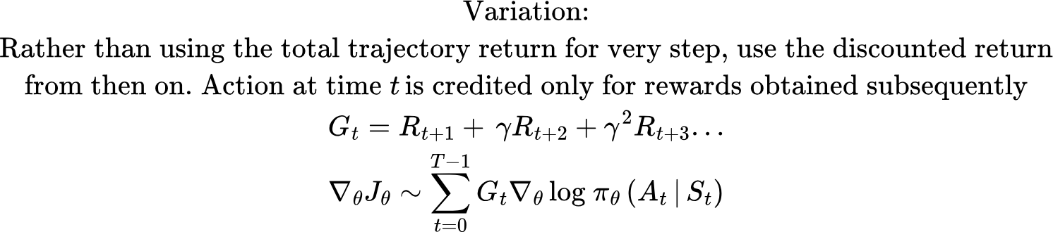
Policy gradient

Slide 11
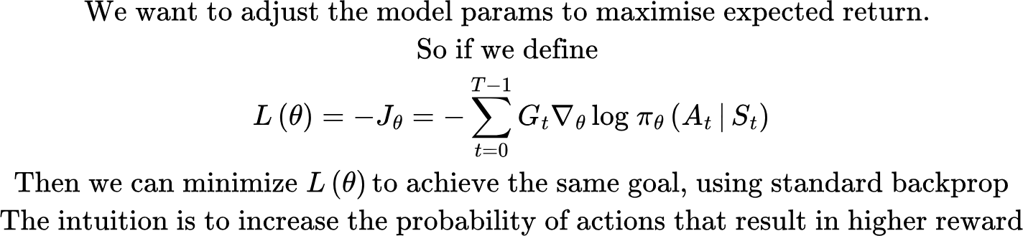
Policy gradient

Slide 12
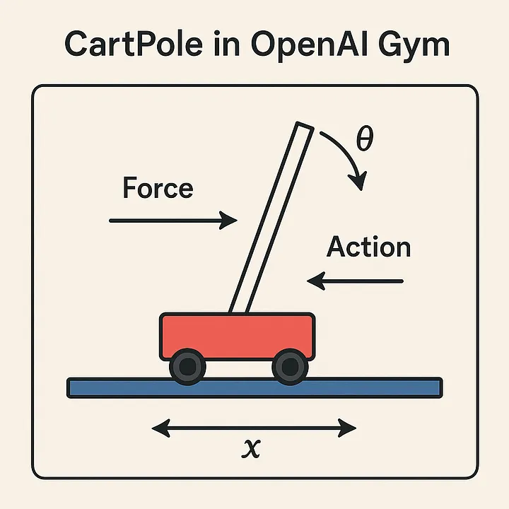
Using Reinforce to solve Cartpole
State:
Cart position (-4.8 to 4.8 units)
Cart velocity (negative or positive)
Pole angle (-12° to 12°)
Pole angular velocity (how fast it is tilting)
Action Space:
0 (left push) or
1 (right push).
Reward:
At every step when the pole remains balanced, you get +1 reward.
Termination: If the angle of the pole is more than ±12° or the cart crosses the boundary of ±2.4 units, then the episode ends

Slide 13
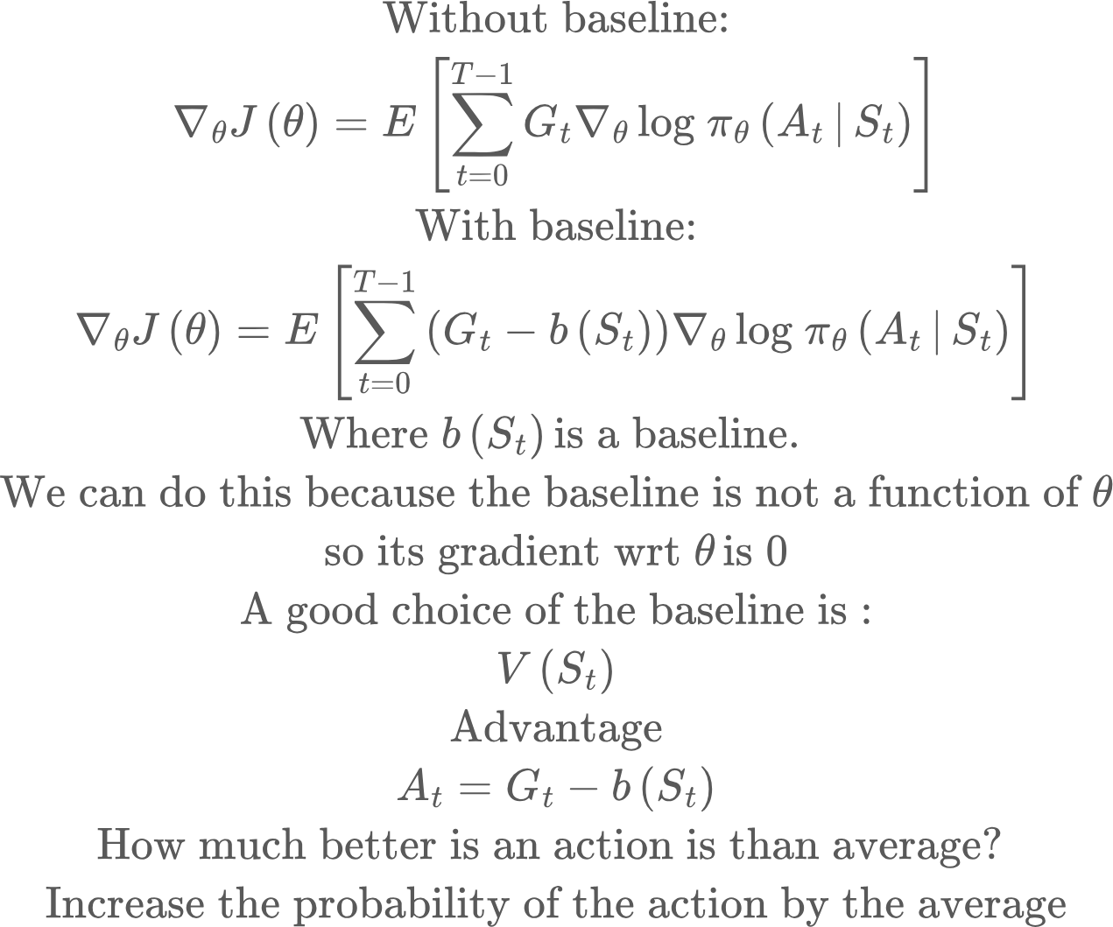
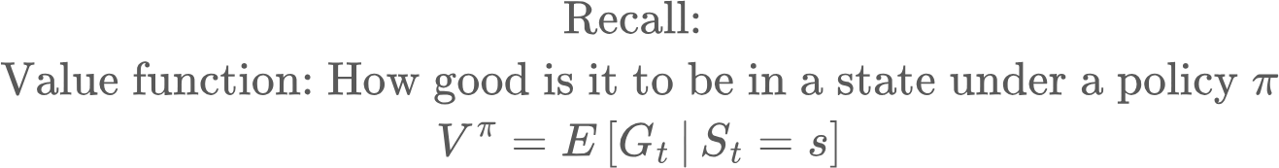
Adding a baseline
The problem with Reinforce is that trajectory returns can vary a lot, which results in high variance gradients. The solution is to add a baseline

Slide 14
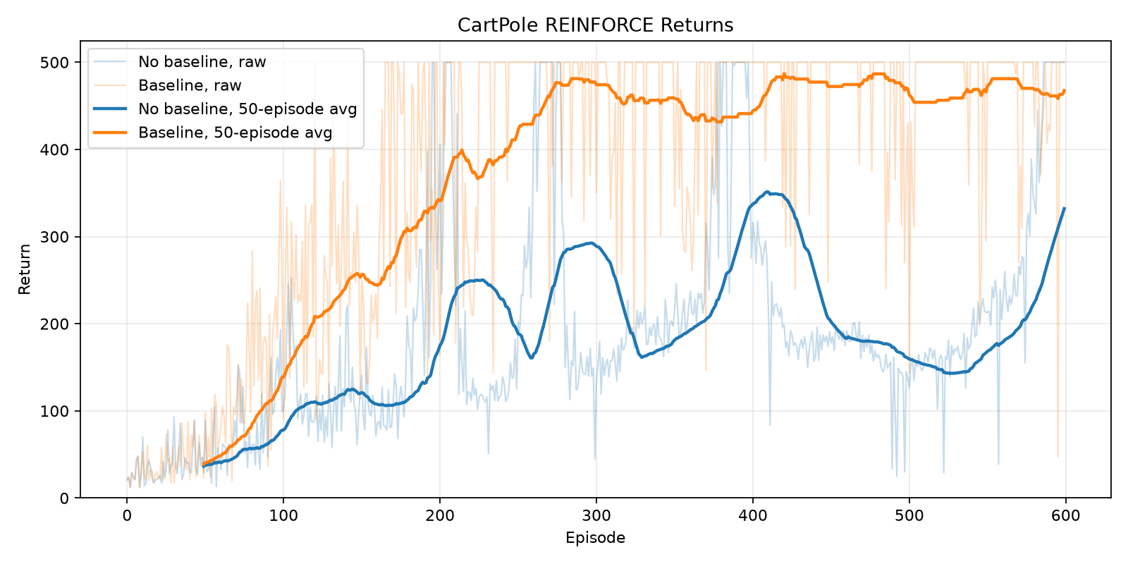
Results
policy_lr = 0.003, critic_lr = 0.01

